Slide 1
Software Design for Cloud 2
Python Programming
Lecture 1
Declan Byrne dbyrne@ait.ie

Slide 2
Python!
Dates from 1991
Interpreted high level language
General purpose Programming language
Python is unambiguous.
Multi-paradigm Language
Structured, Object-Oriented, Functional
Support dynamic typing

Slide 3
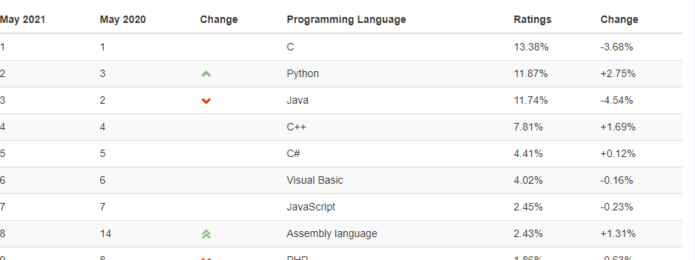

Slide 4
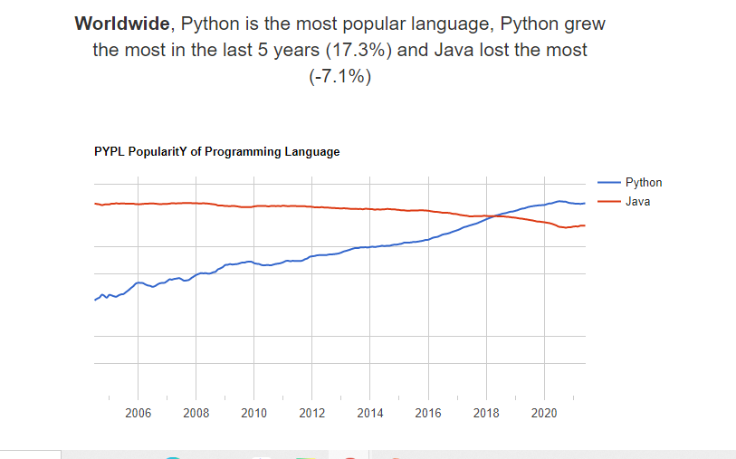

Slide 5
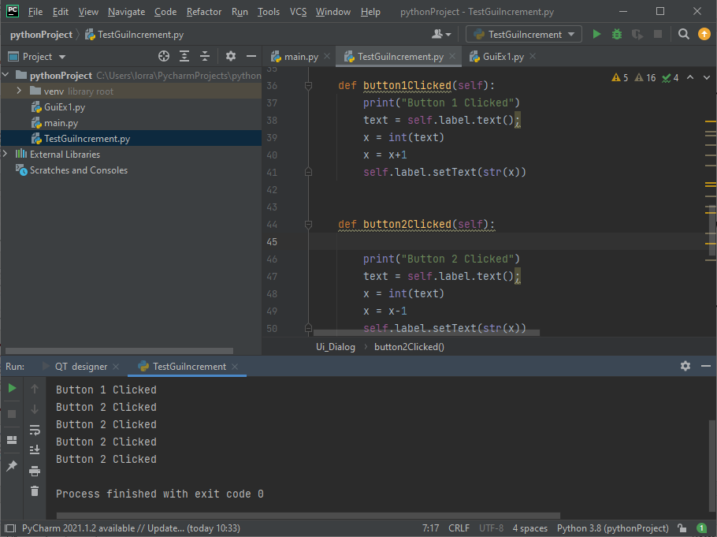

Slide 6
Variables.
A variable is a name that refers to a value.
Form: variable = expression
X = 2
Name=‘John’

Slide 7
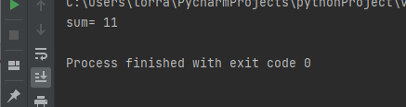
Variables.
def main(): x = 5 y = 6 res = x + y print('sum=', res) main()

Slide 8
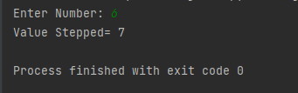
Input (Increment)
def main(): x = int(input('Enter Number: ')) x = x + 1 print('Value Stepped=', x)
main()

Slide 9
EX11
def main(): x = int(input('Enter Number: ')) x = x + 1 print('Value Stepped=', x)
main()
Create a new Python Project & add file Ex11.py (as above)

Slide 10
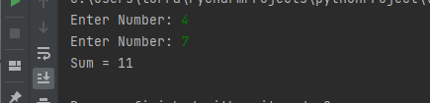
EX12
Now Modify this program to
Enter 2 integers
Add them
Print out the result

Slide 11
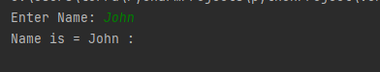
Entering Strings
def main(): first = input('Enter Name: ') print('Name is =', first, ':') main()

Slide 12
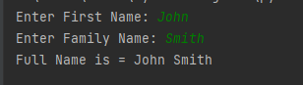
EX13
Now Modify this program to
Enter 2 Strings
Print out the full Name

Slide 13
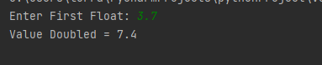
Entering Floats
def main(): first = float(input('Enter First Float: ')) res = first * 2 print('Value Doubled =', res) main()

Slide 14
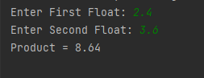
EX14
Now Modify this program to
Enter 2 Floats
Multiply them
Print out the Result

Slide 15
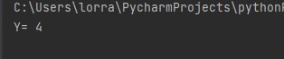
Type Conversion
def main():
# This is a comment
x = 4.5
y = int(x) #translates to int
print('Y=',y)
main()

Slide 16

Type Conversion
def main():
# This is a comment
x = 4.5
y = str(x) #translates to string
print('Y=',y)
main()

Slide 17
Arithmetic Operations
+, -, /, *
5/2= 2
5%2=1
10 / (5 – 3) = 5

Slide 18
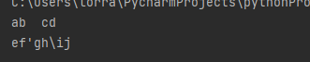
Escape Characters
def main():
print('ab\tcd\nef\'gh\\ij')
main()
\t tab
\n new line
\’ to print ‘
\” to print “
\\ to print \
# print over 2 lines of code
def main():
print('the name of the town is', \
'Athlone’)
main()

Slide 19
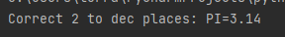
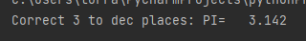
Formatted Output
# print 2 decimal places, no minimum length
def main():
my_pi = 3.1426
print('Correct 2 to dec places: PI=%0.2f' %my_pi)
main()
# print 3 decimal places, 8 min spaces
import math
def main():
my_pi = math.pi
print('Correct 3 to dec places: PI=%8.3f' %my_pi)
main()

Slide 20
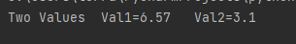
Formatted Output
# print 2 formatted values
def main():
val1=6.567
val2=3.1234
print('Two Values Val1=%0.2f’ %val1 ,' Val2=%0.1f’ %val2)
main()

Slide 21
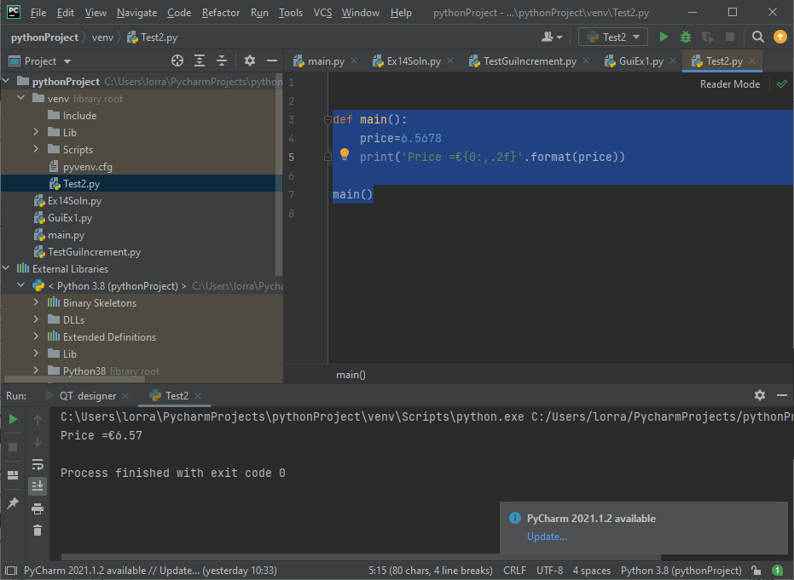
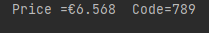
Formatted Output .format (Preferred)
# alternative technique
def main():
price=6.5678
print('Price =€{0:,.2f}'.format(price))
main()
def main():
price=6.5678
code=789
print('Price =€{0:,.3f} Code={1}'.format(price, code))
main()

Slide 22
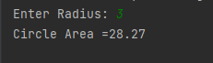

EX15
Prompt the user to enter Circle Radius
Calculate Area = PI * radius * radius ($П$r²)
Print Result correct to 2 places of decimal

Slide 23
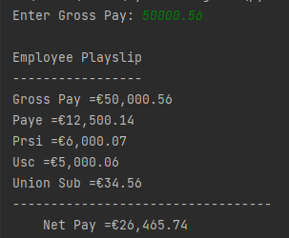
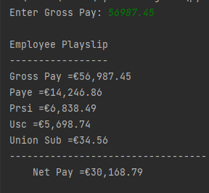
EX16
Prompt the user to enter Gross Pay
Calculate prsi (25% = paye*0.25), prsi(12%),usc(10%), union sub (€34.56)
Print Result in format below

